Slide 1
Sequential Multiple Assignment Randomized Trial for
COMparing Personalized Antibiotic StrategieS (SMART-COMPASS): Design Considerations
Xiaoyan Yin, Toshi Hamasaki, Scott R. Evans
Biostatistics Center, The George Washington University
July 29th, 2020

Slide 2
OUTLINE
Introduction
Research Questions
Statistical Considerations
Results

Slide 3
Introduction: Antibiotic Treatment
Two major decision points
1st decision: empiric therapy
To antibiotic or not to antibiotic?
2nd decision: definitive therapy (48-72 hours later)
Keep or Modify current therapy based on the tailoring criterion?
Tailoring criterion
E.g., Blood culture indicating drug susceptibility / resistance.

Slide 4
Introduction: Strategies & SMART COMPASS
A strategy is a decision-rule guiding patient treatment.
COMPASS: Compare decision-making strategies consistent with clinical practice rather than specific treatments.
When there are multiple empiric-therapy and multiple definitive-therapy options, a SMART COMPASS can be considered.

Slide 5
Introduction: Example
MRSA, methicillin-resistant staphylococcus aureus; BSI, bloodstream infection; Dapto, daptomycin; R, randomization; Vanco,
vancomycin; SMART COMPASS, sequential multiple assignment randomized trials for comparing personalized antibiotic strategies.

Slide 6
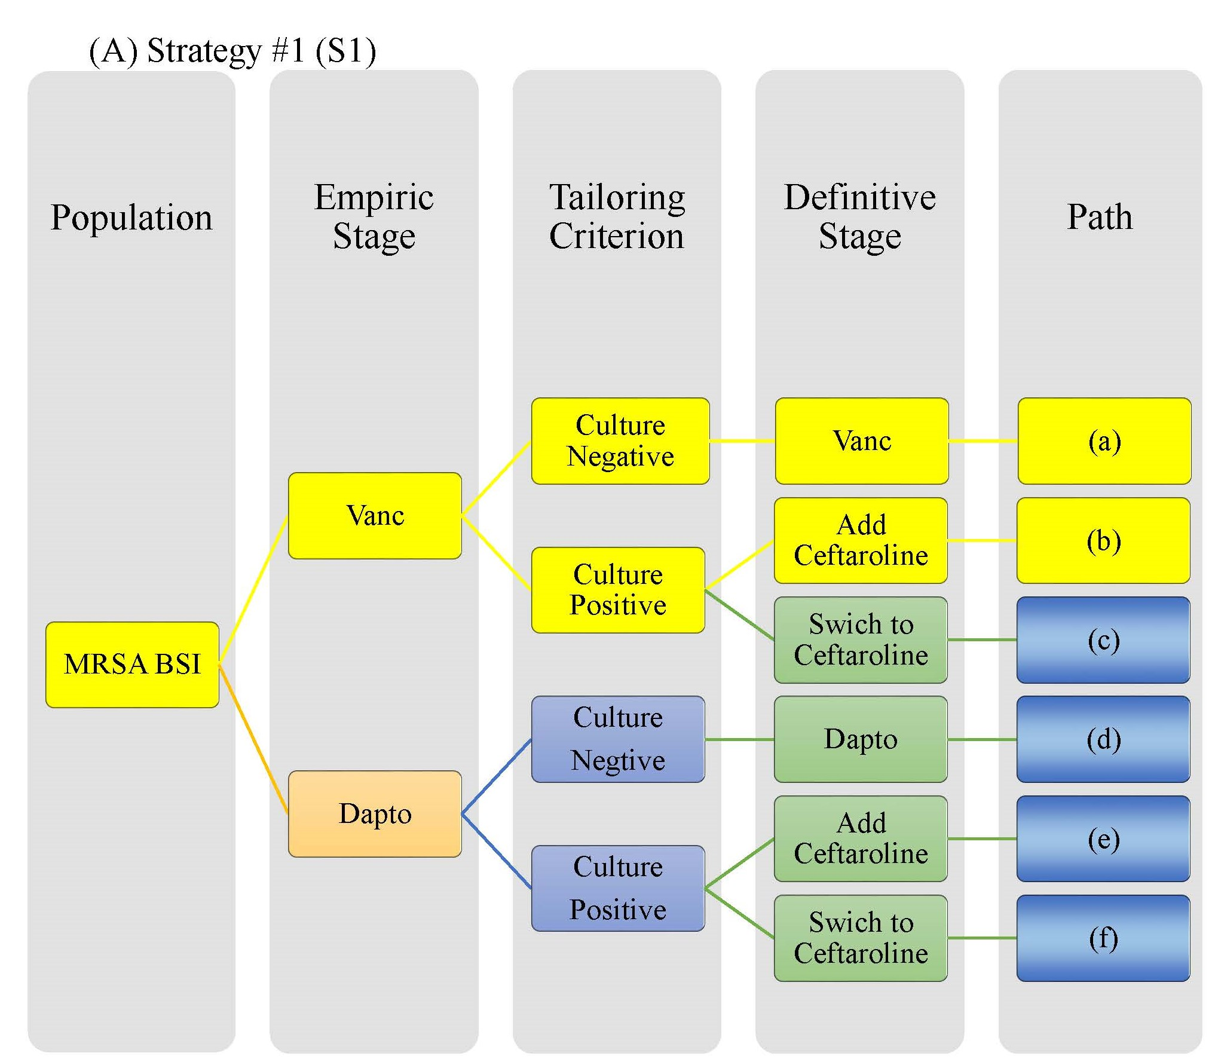
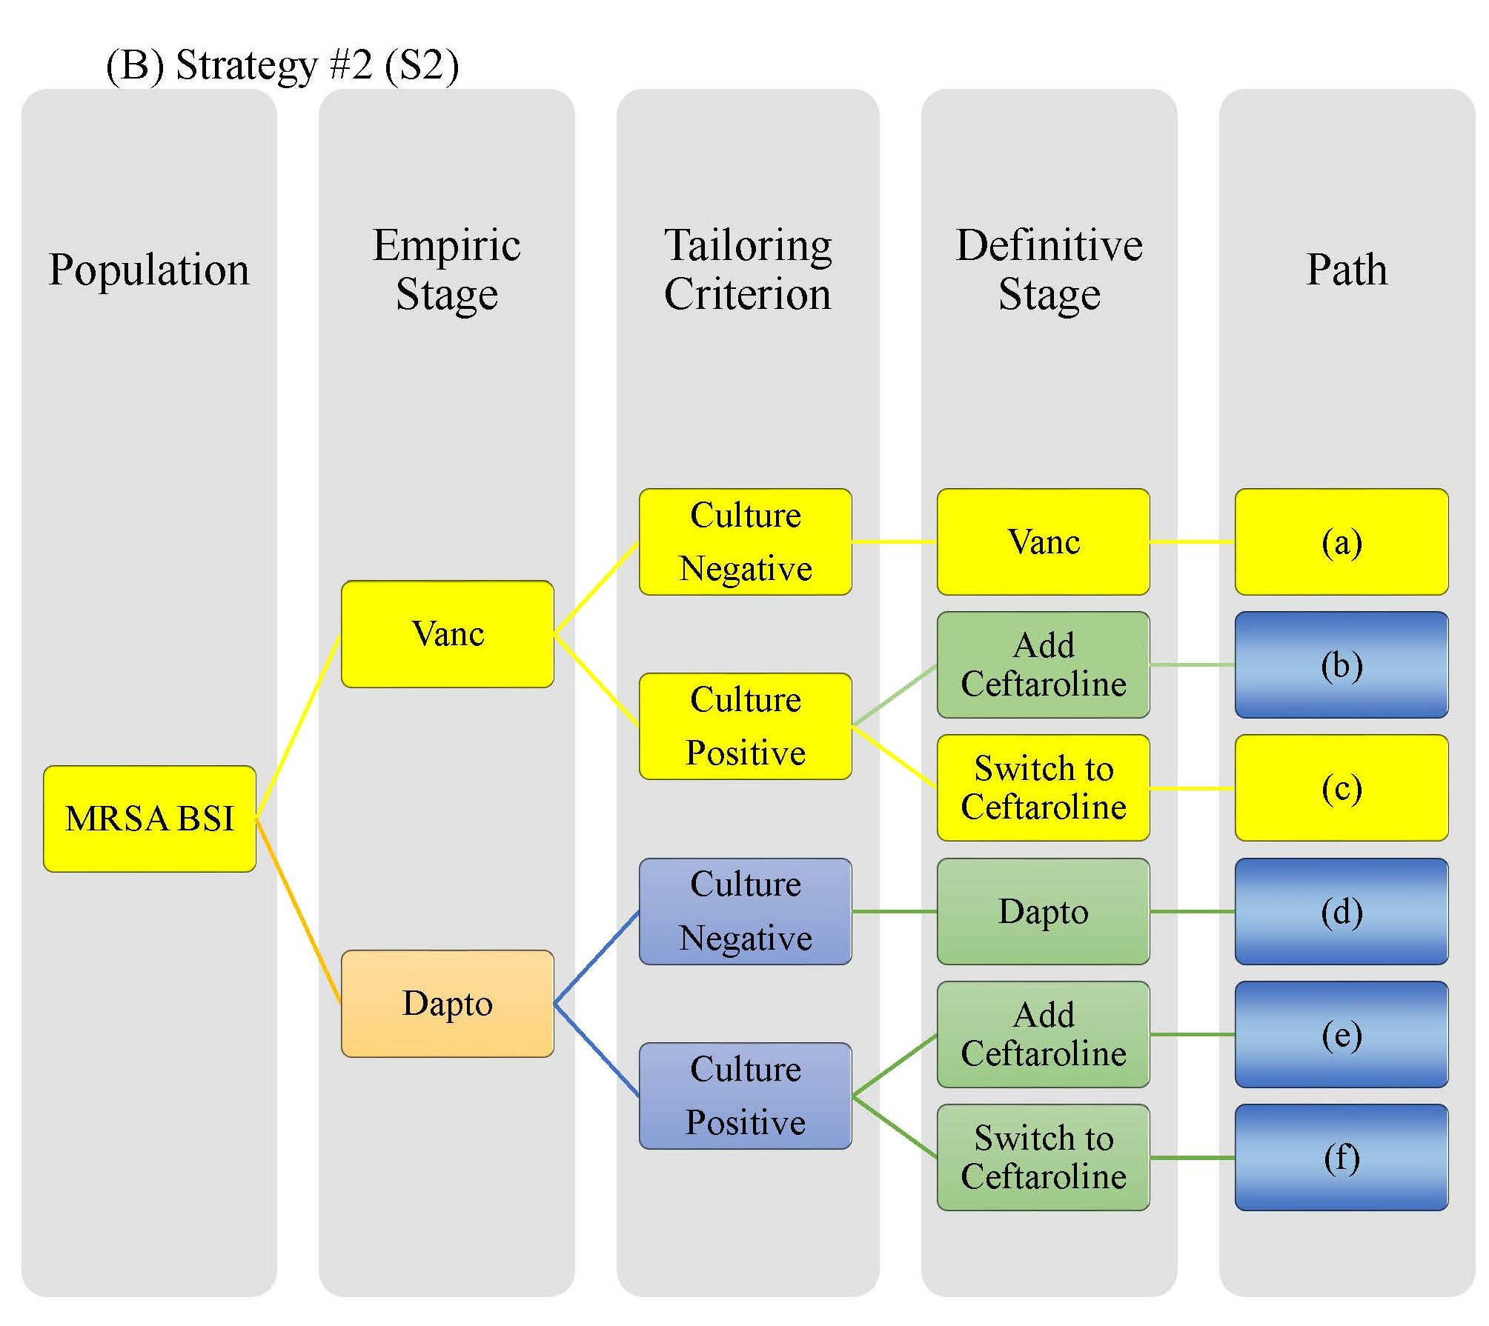
Introduction: Example of SMART COMPASS Comparing 4 Strategies
MRSA, methicillin-resistant staphylococcus aureus; BSI, bloodstream infection; Dapto, daptomycin; Vanco, vancomycin; SMART COMPASS, sequential multiple assignment randomized trials for comparing personalized antibiotic strategies.

Slide 7
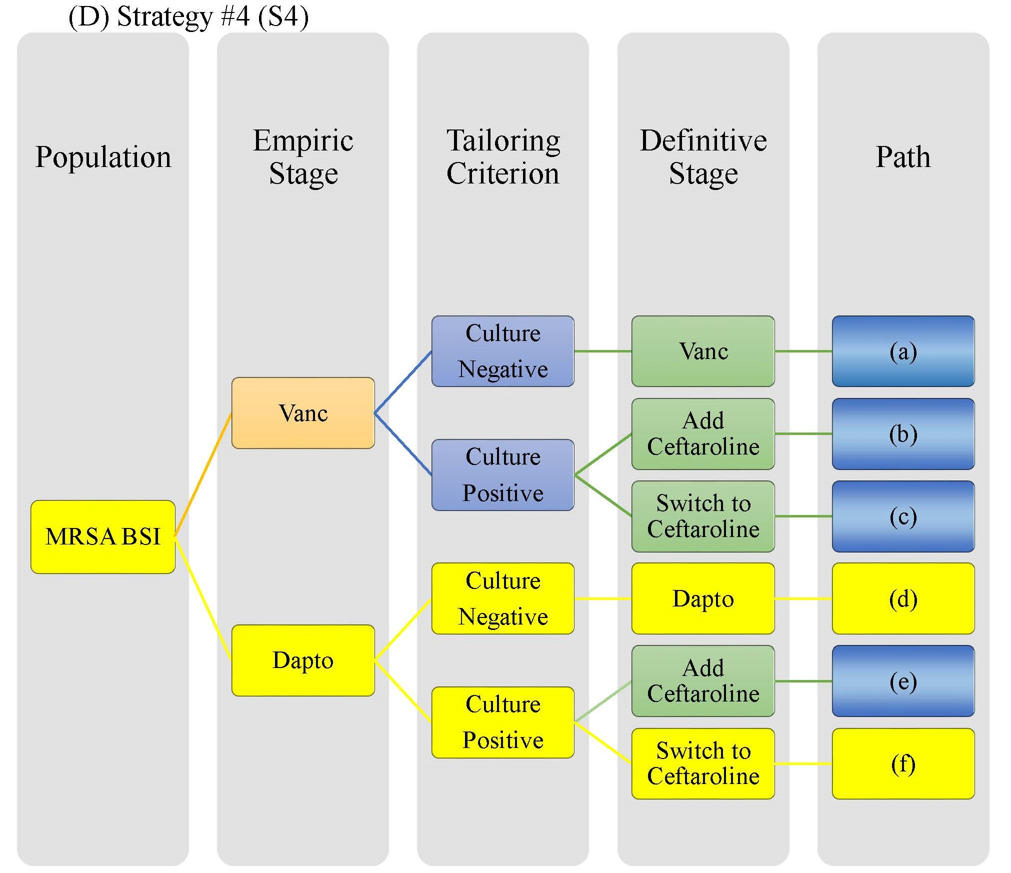
Introduction: Example of SMART COMPASS Comparing 4 Strategies
MRSA, methicillin-resistant staphylococcus aureus; BSI, bloodstream infection; Dapto, daptomycin; Vanco, vancomycin; SMART COMPASS, sequential multiple assignment randomized trials for comparing personalized antibiotic strategies.

Slide 8
Research Questions
Research Questions |  | Example Hypotheses | Contrast of illustrative pathway
Question 1: Comparisons of empiric therapies coupled with different subsequent therapies or Comparisons of definitive therapy conditioning upon empiric therapy |  | Adding Ceftaroline is better than switching to Ceftaroline conditioning upon empiric Vanc. and a positive culture. | Path (b) vs Path (c)
Question 2: Comparisons of strategies | Pairwise comparisons | S1 is better than S3. | Paths (a)+(b) vs Paths (d)+(e)
 | Identification of the best strategy | S1>S2>S3> S4 | Identify best among Paths (a)+(b) vs Paths (a)+(c) vs Paths (d)+(e) vs Paths (d)+(f)

Slide 9
Statistical Consideration
π1
MRSA BSI
( n )
Vanc ( n₁ )
Culture
Positive
Dapto ( n₂ )
Population
Empiric Stage
Tailoring
Criterion
Culture Negative
Culture Negative
Culture
Positive
Add Ceftaroline ( n₁₁ )
Swich to Ceftaroline ( n₁₂ )
Dapto (n₂₀ )
Add Ceftaroline ( n₂₁ )
Swich to Ceftaroline ( n₂₂ )
µ ₁₀
µ ₁₁
Mean Outcome
µ ₁₂
µ ₂₀
µ ₂₁
µ ₂₂
Path
(a)
$${\overline{Y}}_{11}$$
𝑌 ̅_11
(d)
(e)
(f)
Vanc ( n₁₀ )
Sample Size
Sample Mean
$$π_{1}r_{0}n$$
𝜋_1 𝑟_0 𝑛
$${\overline{Y}}_{10}$$
𝑌 ̅_10
(1$−π_{1})r_{0}r_{1}n$
(1−𝜋_1)𝑟_0 𝑟_1 𝑛
(b)
${(1−π}_{1})$
$$r_{0}{(1−r}_{1}) n$$
〖(1−𝜋〗_1)
𝑟_0 〖(1−𝑟〗_1) 𝑛
(c)
$$π_{2}(1{−r}_{0}) n$$
𝜋_2 (1〖−𝑟〗_0) 𝑛
$${\overline{Y}}_{20}$$
𝑌 ̅_20
$${(1−π}_{2})(1−r_{0})r_{2}n$$
〖(1−𝜋〗_2)(1−𝑟_0)𝑟_2 𝑛
$${\overline{Y}}_{21}$$
𝑌 ̅_21
$${\overline{Y}}_{22}$$
𝑌 ̅_22
$${\overline{Y}}_{12}$$
𝑌 ̅_12
$${ (1−π}_{2})(1−r_{0}){(1−r}_{2})n$$
〖 (1−𝜋〗_2)(1−𝑟_0)〖(1−𝑟〗_2)𝑛
Definitive Stage
$$π_{1}$$
$$r_{1}$$
$$r_{0}$$
R
R
$${1−π}_{1}$$
$${1−r}_{1}$$
$$1−{ r}_{0}$$
$$π_{2}$$
$$r_{2}$$
R
$${1−π}_{2}$$
$${1−r}_{2}$$

Slide 10
Statistical Consideration: Statistical Setting
MRSA BSI
( n )
Vanc ( n₁ )
Culture
Positive
Dapto ( n₂ )
Population
Empiric Stage
Tailoring
Criterion
Culture Negative
Culture Negative
Culture
Positive
Add Ceftaroline ( n₁₁ )
Swich to Ceftaroline ( n₁₂ )
Dapto (n₂₀ )
Add Ceftaroline ( n₂₁ )
Swich to Ceftaroline ( n₂₂ )
µ ₁₀
µ ₁₁
Mean Outcome
µ ₁₂
µ ₂₀
µ ₂₁
µ ₂₂
Path
(a)
$${\overline{Y}}_{11}$$
𝑌 ̅_11
(d)
(e)
(f)
Vanc ( n₁₀ )
Sample Size
Sample Mean
$$π_{1}r_{0}n$$
𝜋_1 𝑟_0 𝑛
$${\overline{Y}}_{10}$$
𝑌 ̅_10
(1$−π_{1})r_{0}r_{1}n$
(1−𝜋_1)𝑟_0 𝑟_1 𝑛
(b)
${(1−π}_{1})$
$$r_{0}{(1−r}_{1}) n$$
〖(1−𝜋〗_1)
𝑟_0 〖(1−𝑟〗_1) 𝑛
(c)
$$π_{2}(1{−r}_{0}) n$$
𝜋_2 (1〖−𝑟〗_0) 𝑛
$${\overline{Y}}_{20}$$
𝑌 ̅_20
$${(1−π}_{2})(1−r_{0})r_{2}n$$
〖(1−𝜋〗_2)(1−𝑟_0)𝑟_2 𝑛
$${\overline{Y}}_{21}$$
𝑌 ̅_21
$${\overline{Y}}_{22}$$
𝑌 ̅_22
$${\overline{Y}}_{12}$$
𝑌 ̅_12
$${ (1−π}_{2})(1−r_{0}){(1−r}_{2})n$$
〖 (1−𝜋〗_2)(1−𝑟_0)〖(1−𝑟〗_2)𝑛
Definitive Stage
$$π_{1}$$
Consider a SMART COMPASS
with
a continuous
primary endpoint
with
a common known variance${ σ}^{2}$
among strategies
$$r_{0}$$
$$r_{1}$$
R
R
$${1−π}_{1}$$
$${1−r}_{1}$$
$$1−{ r}_{0}$$
$$π_{2}$$
$$r_{2}$$
$${1−π}_{2}$$
R
$${1−r}_{2}$$

Slide 11
Statistical Considerations: Pairwise Comparisons of Strategies
Question: Is S1 better than S3 ?
Strategy Comparison | Parameter | Hypothesis |  | $${\hat{δ}}_{13}={\hat{μ}}_{S1}−{\hat{μ}}_{S3}$$
S1 vs S3 | $$δ_{13}=μ_{S1}−μ_{S3}$$ | $H_{0}: δ_{13}≤0$ VS $H_{1}: δ_{13}>0$ |  | $$\frac{π_{1}{\overline{Y}}_{10}+r_{1}(1−π_{1}){\overline{Y}}_{11}}{π_{1}{+r}_{1}(1−π_{1})} −\frac{π_{2}{\overline{Y}}_{20}+r_{2}(1−π_{2}){\overline{Y}}_{21}}{π_{2}{+r}_{2}(1−π_{2})}$$
Strategy Comparison | Test Statistic | $$E\left[{\hat{δ}}_{13}\right]$$ |  | V$ar\left[{\hat{δ}}_{13}\right]$
S1 vs S3 | $$Z_{13}=\frac{{\hat{δ}}_{13}}{var[{\hat{δ}}_{13}]}$$ | $$\frac{π_{1}μ_{10}+r_{1}(1−π_{1})μ_{11}}{π_{1}{+r}_{1}(1−π_{1})} −\frac{π_{2}μ_{20}+r_{2}(1−π_{2})μ_{21}}{π_{2}{+r}_{2}(1−π_{2})}$$ |  | $$\frac{σ^{2}}{n}\left\{\frac{1}{r_{0}(π_{1}+r_{1}(1−π_{1}))}+\frac{1}{(1−r_{0})(π_{2}+r_{2}(1−π_{2}))}\right\}$$
Strategy Comparison | $$N_{13}$$ |  | $$N_{13}^{∗}$$
S1 vs S3 | $$N_{13} =\left\{\begin{aligned}N_{13}^{∗} , if N_{13}^{∗} is integer, \\ \left[N_{13}^{∗}\right]+1, otherwise,\end{aligned}\right.$$ |  | $$N_{13}^{∗}=\frac{{4σ^{2}\left(z_{1−α}+z_{1−β}\right)}^{2}}{{(δ_{13}^{∗})}^{2}}\left\{\frac{1}{r_{0}(π_{1}+r_{1}(1−π_{1}))}+\frac{1}{(1−r_{0})(π_{2}+r_{2}(1−π_{2}))}\right\}$$
$μ_{Si}$ is the mean of the strategy $i$, and estimated by weighting the paths’ sample means, $i=1,…4$.
$N_{13}$is the total sample size required for achieving the desired power $1 − β$ at the significance level $α$ in S1 vs S3.
$δ_{13}^{∗}$ is the clinically meaningful difference.

Slide 12
Results: Pairwise Comparisons of Strategies
Required sample size $N_{13}$ under varying $π_{1}$ and $π_{2}$. The sample size was calculated to detect the assumed mean difference between the S1 and S3 with the power of 80% at the one-sided significance level of 2.5%, where $σ^{2}$ $=$1, $r_{0}=r_{1}=r_{2}=0.5,$ and${ μ}_{10}=1, μ_{20}=0.5,$ $μ_{S1}=1,μ_{S2}=0.8, μ_{S3}=0.6, μ_{S4}=0.4$.

Slide 13
Statistical Considerations: Sequential Testing Procedure
Question: Which is the best strategy among S1 ~ S4?
Step 1: Start by ordering the estimated mean values ${\hat{μ}}_{S(1)}$, ${\hat{μ}}_{S(2)}$, ${\hat{μ}}_{S(3)}$ and ${\hat{μ}}_{S(4)}$, where ${\hat{μ}}_{S(4)}<{\hat{μ}}_{S(3)}<{\hat{μ}}_{S(2)}<{\hat{μ}}_{S\left(1\right)}.$
Step 2: The order in which hypotheses are tested is $H_{0(14)}→H_{0\left(13\right)}→H_{0(12)}$ and each test is carried out at
the significance level of $α$ as long as significant results are observed in all preceding tests.
$$α$$
0
0
$$H_{0\left(13\right)}$$
$$H_{0\left(12\right)}$$
$$H_{0\left(14\right)}$$
S($i$) is the ordered strategy of S1 to S4 by the estimated mean values; $i=1,…4$.
${\hat{μ}}_{S(i)}$is estimated mean of ordered strategies S($i$); $i=1,…4.$
$δ_{(ij)}=μ_{S(i)}−μ_{S\left(j\right)};$ ${ δ}_{ij}=μ_{Si}−μ_{Sj}; i,j=1,…4, i≠j.$
$H_{0(ij)}: δ_{\left(ij\right)}≤0.$The associated three null hypotheses are $H_{0\left(14\right)},H_{0(13)}{,and H}_{0(12)}$ for the comparisons of S(1) with S(4), S(3), and S(2), respectively.

Slide 14
Results: Identify the Best Strategies
$$π_{1}$$ | $$π_{2}$$ | $$N$$ | Marginal Power |  | Conditional Power
 |  |  | $$Pr[H_{1\left(12\right)}]$$ | $${Pr[H}_{1\left(13\right)}]$$ | $Pr[H_{1\left(14\right)}$] | $$Pr[{H_{1\left(13\right)}|H}_{1\left(14\right)}]$$ | $$\operatorname{Pr}\left[{H_{1\left(12\right)}|H}_{1\left(13\right)}{⋂H}_{1\left(14\right)}\right]$$
0.5 | 0.1 | 691 | 0.803 | 0.986 | >0.999 | 0.986 | 0.800
 | 0.3 | 688 | 0.802 | 0.992 | >0.999 | 0.992 | 0.799
 | 0.5 | 684 | 0.801 | 0.995 | >0.999 | 0.995 | 0.800
 | 0.7 | 684 | 0.803 | 0.996 | >0.999 | 0.996 | 0.801
 | 0.9 | 683 | 0.802 | 0.997 | >0.999 | 0.997 | 0.800
The total sample size $N$ required to satisfy the desired power $1−β=\operatorname{Pr}\left[{H_{1\left(12\right)}|H}_{1\left(13\right)}{⋂H}_{1\left(14\right)}\right]=$80% at the one-sided significance level of 2.5%, and empirical marginal and conditional powers under $N,$ where $σ^{2}$ $=$1 and${ μ}_{10}=1, μ_{20}=0.5,$ $μ_{S(1)}=μ_{S1}=1,{μ_{S(2)}=μ}_{S2}=0.8, {μ_{S(3)}=μ}_{S3}=0.6, {μ_{S\left(4\right)}=μ}_{S4}=0.4$.

Slide 15
Thanks!

